Slide 1




Chikungunya Infection During Gestation: Impact on Pregnancy and Neonatal Outcomes

Slide 2
Chikungunya Virus
Chikungunya (CHIKV): mosquito-borne (Aedes spp.) positive sense RNA Alphavirus in the family Togaviridae
Officially discovered in 1952 by R. W. Ross on the Makonde plateau in Tanzania: Makonde language for “that which bends up”
Causes chikungunya disease in humans (3-7 days incubation):
Joint and body pain (arthralgia)
Fever
Headache
Nausea
Vomiting
Rash
Acute (days to weeks) and chronic (months to years) phases

Slide 3
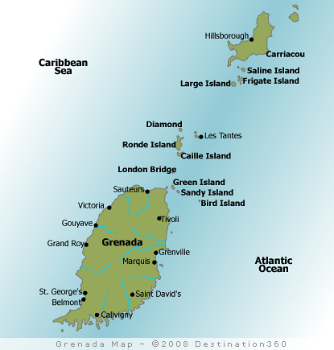

Chikungunya Virus in Grenada
CHIKV emerged in the Americas (via Caribbean) December 2013 (St. Martin)
Main island of a tri-island state of Grenada, Carriacou, and Petit Martinique in the southern Antilles
First reported in Carriacou in June 2014 and then quickly spread to all 6 parishes in Grenada
By December 2014: 65% of the population was infected with CHIKV (MOH, Grenada)^{1,2}
¹Jungkind et al., 2015 ²Macpherson et al., 2016

Slide 4
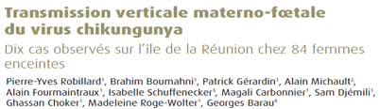
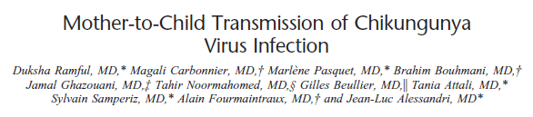
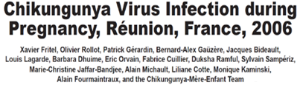
Maternal-Fetal Transmission of Chikungunya Virus

Slide 5
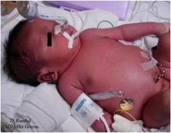
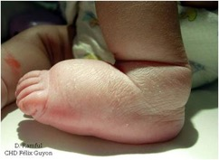
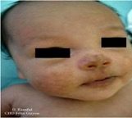
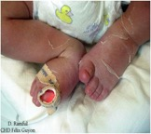
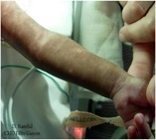
Mother-to-child Transmission
Exclusively occurs in the context of intrapartum maternal viremia and often leads to severe neonatal infections
Rate of MTCT during pregnancy = 2.5%
19 of 739 exposed neonates became infected (near-term delivery)
10 of 19 babies became seriously ill: brain swelling; bleeding
4 of 19 babies: lasting disabilities at end of study
Case fatality rate = 2 - 5%
Rate of MTCT DURING DELIVERY = 50%
Common neonatal symptoms include: Fever (100%)
Pain (100%)
Suckling difficulties (100%)
Rash (89%)
Distal limb edema (84%)
At 2 years, Mean DQ 83 and 51% had Global Neurodevelopmental Delays
At 10 years, survivors have language delays, hearing and visual impairment and need for PT and OT.
Gérardin P et al, PLoS Med, 2008; Ramful D et al, Pediatr Infect Dis J 2007; Ritz N, et al, Pediatr Infect Dis J 2015; Gérardin P et al, PLoS Negl Trop Dis, 2014; Gérardin P, A.D. LaBeaud et al, 2016
Notes:
Mother-to-child chikungunya virus transmission is frequent in the context of intrapartum maternal viremia, and often leads to severe neonatal infection. Chikungunya represents a substantial risk for neonates born to viremic parturients that should be taken into account by clinicians and public health authorities in the event of a chikungunya outbreak.
Systematic review
Overall rate of MTCT = 9.5%
Vertical transmission rate was 39% (172/439) for pregnant women infected at >35 weeks gestation
Case fatality rate = 2 - 5%
Viremic phase:
Median onset: 4 days (range 3-7 days)
Fever (100%)
Pain (100%)
Suckling difficulties (100%)
Rash (89%)
Distal limb edema (84%)
Post-viremic phase:
Hyperpigmentation
Peeling
19 children with congenital CHIKV:
Severe encephalopathy (9)
Non-encephalopathic CHIKV (10)
13 children assessed at follow up:
Language delays requiring speech therapist (7)
Hearing impairment (2)
Central deafness (1)
Visual impairment (4)
Cortical blindness (1)
Myopia (2)
Strabismus (1)
Need for physical therapy (4)
Need for orthopedic care (3)
Botulinum toxin required for spasticity (2)

Slide 6
CHIKV Pregnancy Outcomes & Infant Neurodevelopment in Grenada
Study CHIKV impacts on pregnancy outcomes and infant neurodevelopment during the outbreak in Grenada
Mothers who gave birth during the 2014 CHIKV outbreak and up to 1 year after the outbreak recruited (target n=1,000)
Demographics and symptom data, pregnancy and neonatal outcomes, child neurodevelopment at 2 years of age compared among those exposed versus not exposed to CHIKV
Study is ongoing through August 2018

Slide 7
CHIKV Pregnancy Outcomes & Infant Neurodevelopment in Grenada
Aims
1. Determine the prevalence of MTCT of CHIKV in Grenadian pregnant mothers
2. Measure neurodevelopment in children at 2 years of age exposed to CHIKV at different trimesters in utero
3. Assess the burden of confounding factors to better understand the specific impact of VBD on neurodevelopment and inform public health priorities
4. Build local capacity for arboviral and neurodevelopmental testing at St. George’s University in Grenada

Slide 8


CHIKV Pregnancy Outcomes & Infant Neurodevelopment in Grenada
Enroll approximately 1000 mothers and their children who gave birth during and after the CHIKV outbreak
Completion of multiple questionnaires about home environment, relationships, food security and pregnancy outcomes
Measure child’s neurodevelopment using Intergrowth-21st Neurodevelopment Assessment (interNDA) including hearing and vision
Test mother and child blood for prior exposure to CHIKV using InBIOS IgG ELISA
Compare neurodevelopment in those children born to mothers with CHIKV exposure during pregnancy to those with mothers infected outside of pregnancy

Slide 9





CHIKV Pregnancy Outcomes & Infant Neurodevelopment in Grenada
NEG
75/415
18.1%
POS
14/415
3.4%
NEG
401/415
96.6%
POS
340/415
81.9%

Slide 10
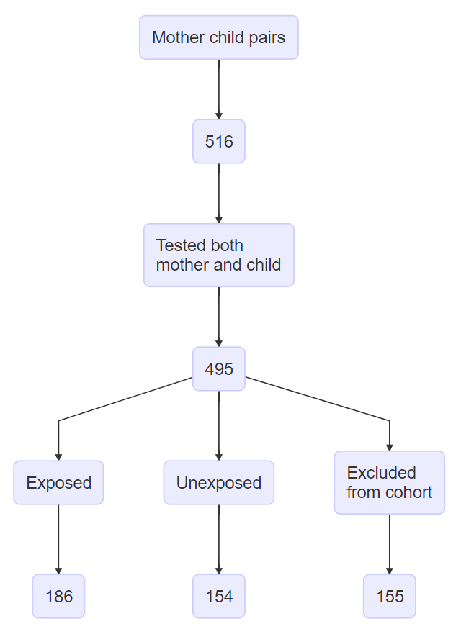
Cohort
Exposed (if both)
Mother IgG+
AND infected during pregnancy
Unexposed (if either)
Mother IgG -
OR not infected during pregnancy
Excluded
122 CHIKV+ without timing of infection information
26 no recall if infected during pregnancy
1 equivocal lab result
5 CHIKV+ w/o recall of disease
1 recalled disease during pregnancy but not CHIKV+

Slide 11
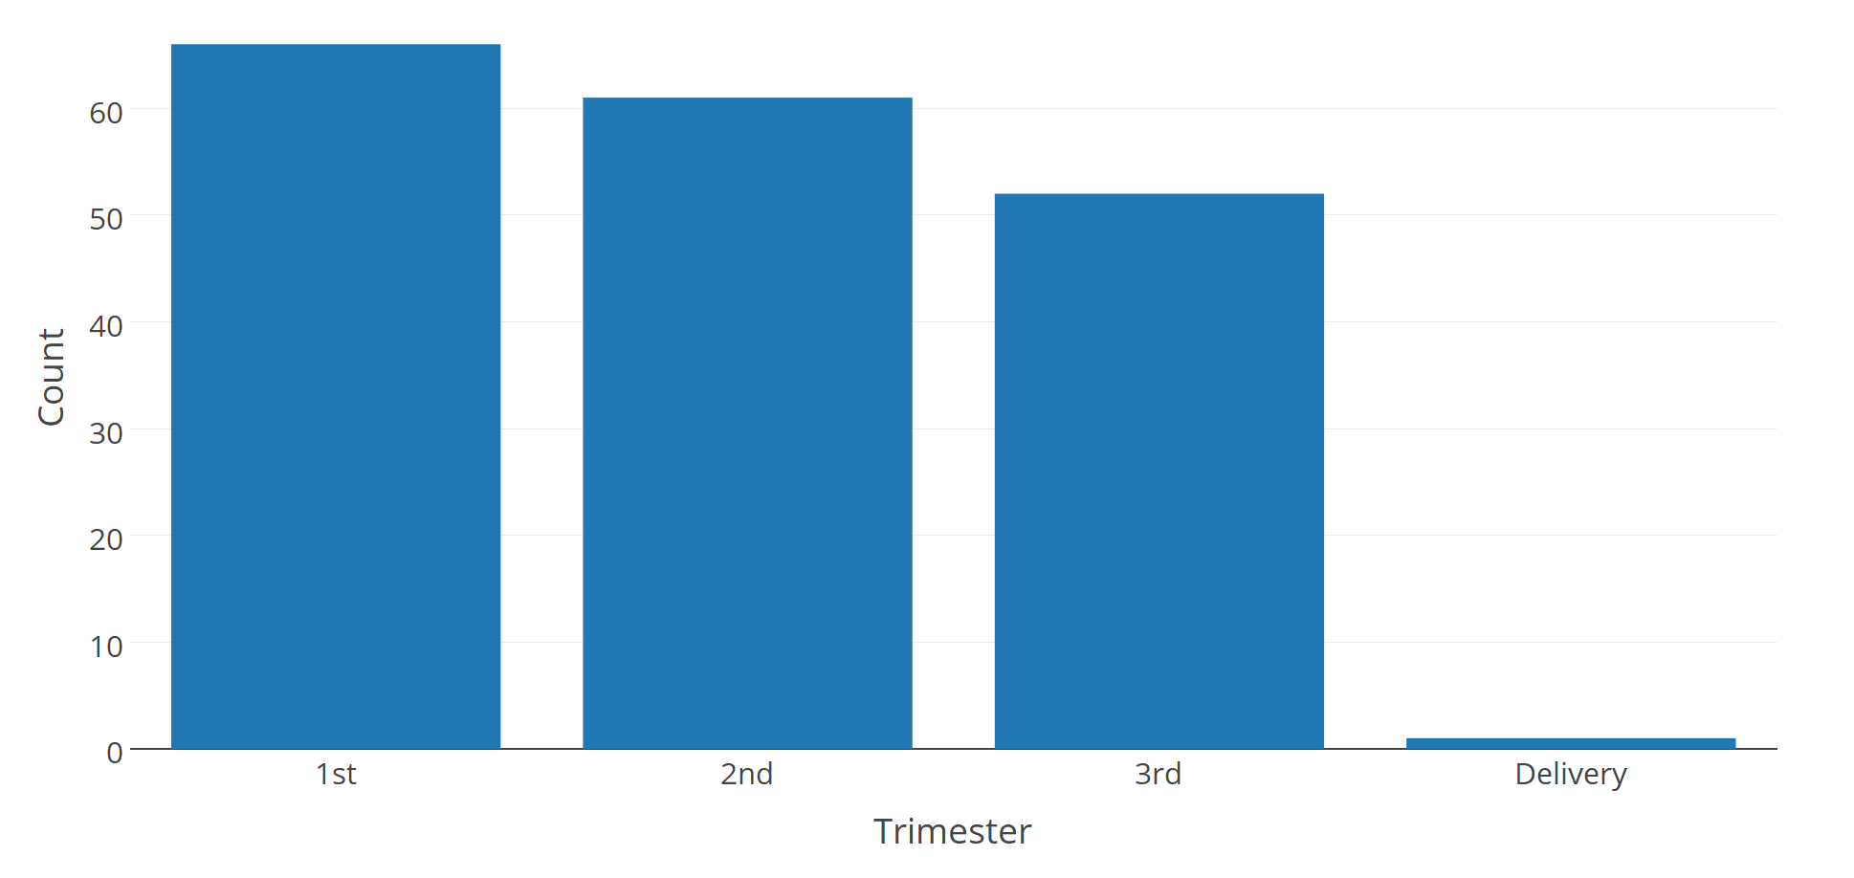
Trimester of Infection
66
61
52
1

Slide 12
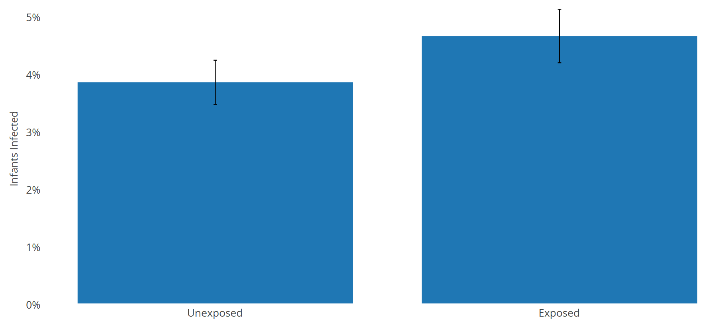
IgG Positive Infants by Mother exposure status
(n=154)
(n=179)
p= 0.956

Slide 13
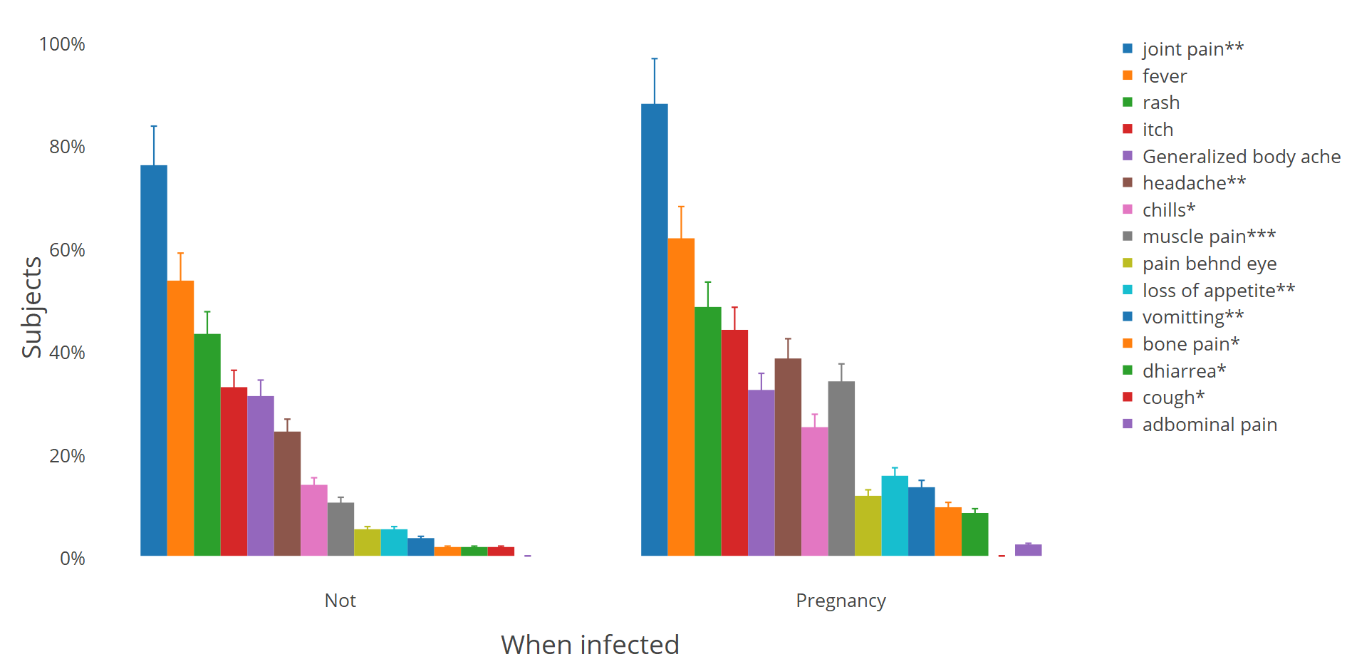
CHIKV symptoms during pregnancy vs not
(n=93)
(n=198)
***<0.001.**p<0.05. *p<0.10

Slide 14
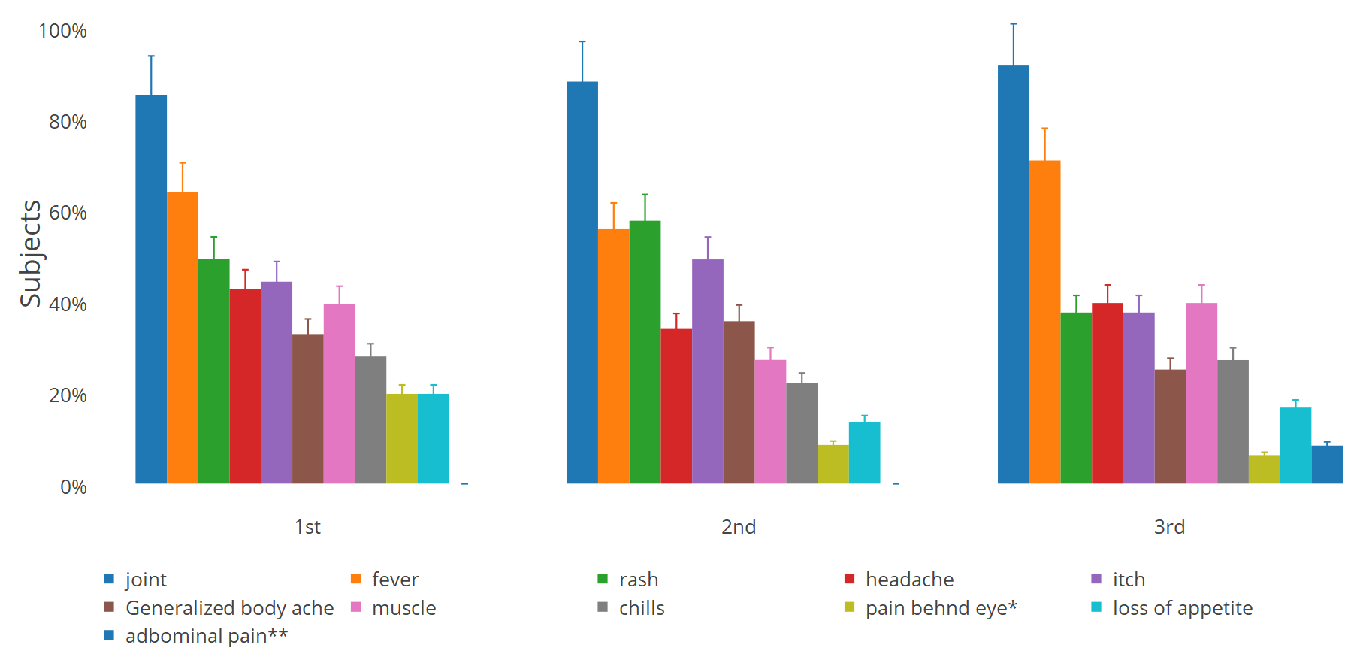
Symptoms by Trimester of Infection
(n=70)
(n=61)
(n=53)
**p<0.05. *p<0.10

Slide 15
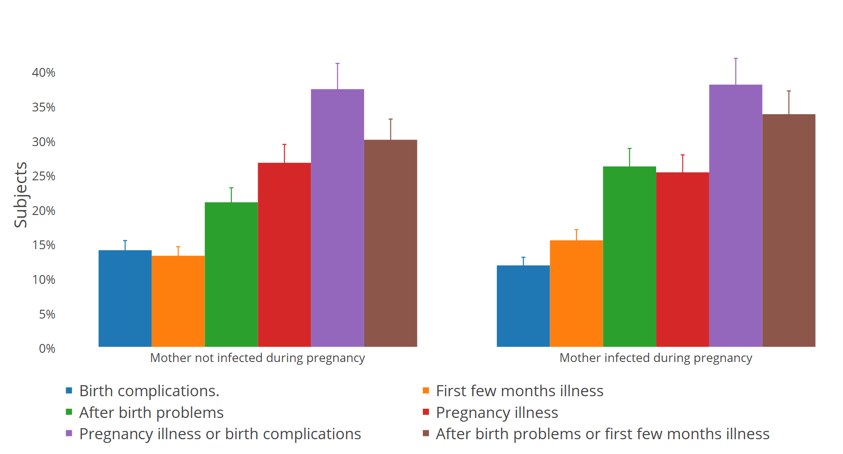
Pregnancy and birth complications
Notes:
See table.

Slide 16
Birth Time by Exposure
p=0.7
Notes:
Unexposed 39.69 weeks vs 39.71 weeks for exposed.

Slide 17
Height Weight
P=0.9
P=0.03

Slide 18
Conclusions
Ongoing study adds to the limited data on the effects of CHIKV infection during pregnancy on birth outcomes
No difference between child infection rates in mothers exposed during pregnancy vs. unexposed/exposed outside of pregnancy
Pregnant women had similar symptoms, but were more symptomatic than non-pregnant women
Symptoms did not vary by trimester
There was a trend toward more after birth complications in the CHIKV gestationally exposed group
There were no differences in first, second, third trimester
No differences in gestational age at delivery or pregnancy complications
CHIKV gestationally exposed infants were heavier at 2 years than unexposed

Slide 19


Acknowledgements
WINDREF/St. George’s University
Randall Waechter, Trevor Noel, Calum MacPherson, Nikita Cudjoe, Veronica Mapp, field teams
Stanford University
Priyanka Suresh, Amy Krystosik
Grenada MOH
George Mitchell
Our study participants
Our Funders: NIH Fogarty (1R21TW010536 – LaBeaud & Waechter)

